Slide 1
Help Wanted Online A real-time measure of job postings
February 2021
Office of Research Connecticut Department of Labor
Connecticut Department of Labor – Research Office 200 Folly Brook Blvd. Wethersfield, CT 06109
Help Wanted Online

Slide 2
What is HWOL?
The Conference Board Help Wanted Online® Data Series (HWOL) measures the number of new, first-time Online job postings and jobs reposted from the previous month for over 50,000 Internet job boards, corporate boards and smaller job sites that serve niche markets and smaller geographic areas.
Connecticut Department of Labor – Research Office 200 Folly Brook Blvd. Wethersfield, CT 06109
Help Wanted Online

Slide 3
Upcoming Release Dates
Monthly Report: Wednesday, March 24, 2021 Wednesday, April 23, 2021 Wednesday, May 26, 2021 Weekly New Ads Report: Updated every Friday
Connecticut Department of Labor – Research Office 200 Folly Brook Blvd. Wethersfield, CT 06109
Help Wanted Online

Slide 4
Statewide Weekly New Job Ads
Weekly New job postings were 4,613 during the week ending 2/13/21.
Connecticut Department of Labor – Research Office 200 Folly Brook Blvd. Wethersfield, CT 06109
Help Wanted Online

Slide 5
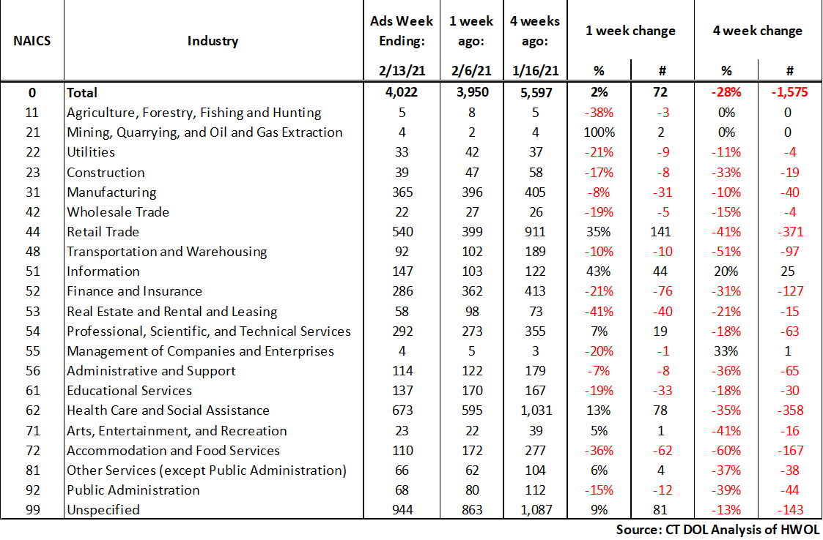
HWOL New Weekly Industry Job Ads – CT Statewide
Connecticut Department of Labor – Research Office 200 Folly Brook Blvd. Wethersfield, CT 06109
Help Wanted Online

Slide 6
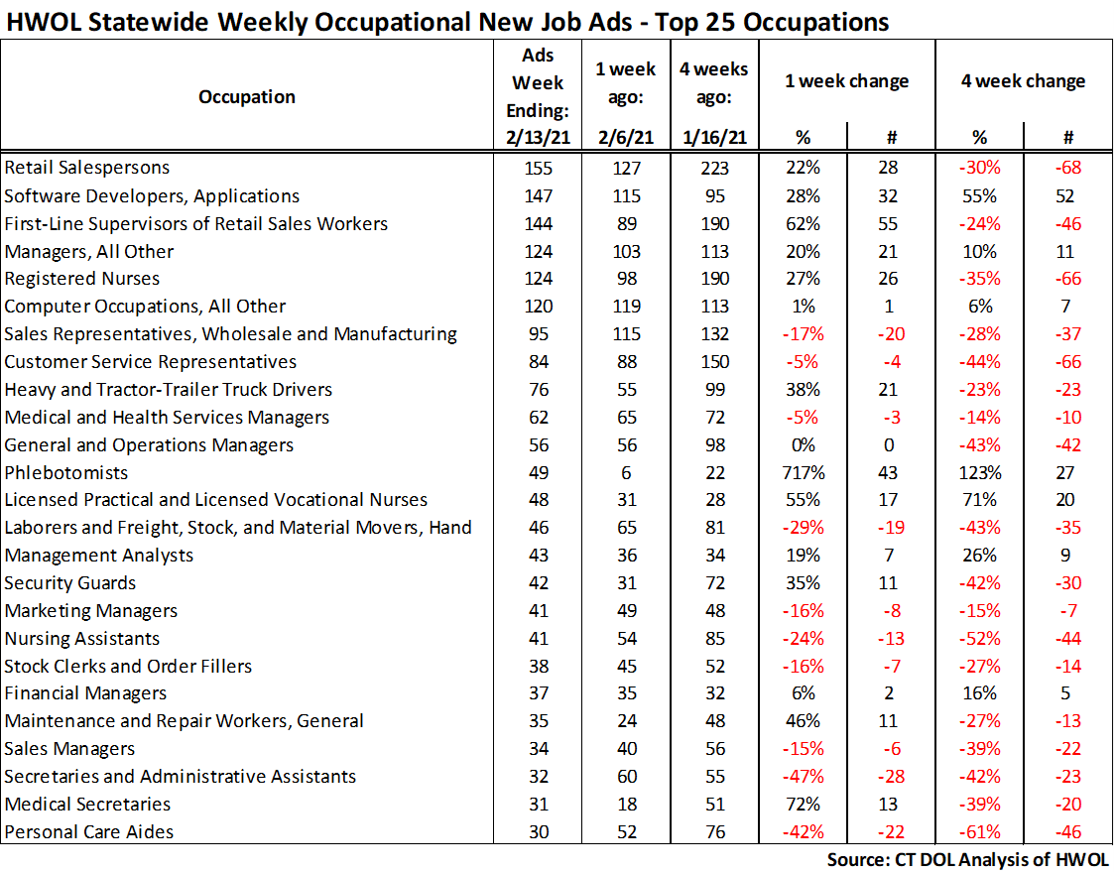
Connecticut Department of Labor – Research Office 200 Folly Brook Blvd. Wethersfield, CT 06109
Help Wanted Online

Slide 7
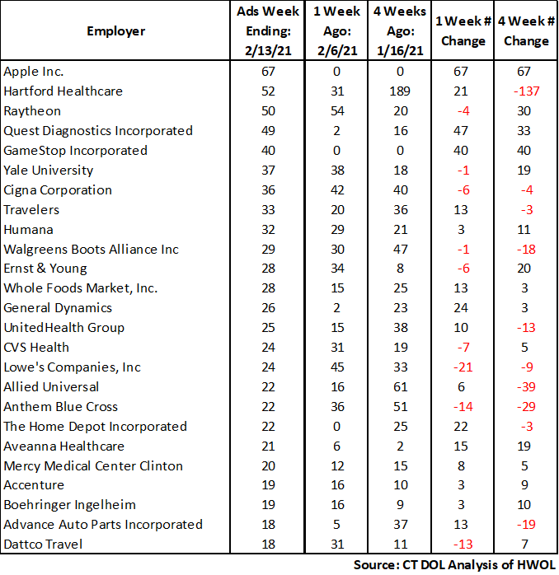
Employers with the Most New Job Postings
Connecticut Department of Labor – Research Office 200 Folly Brook Blvd. Wethersfield, CT 06109
Help Wanted Online

Slide 8
Monthly HWOL Information
The following pages contain HWOL monthly data for January 2021. Monthly and weekly job ad information can be found here: https://www1.ctdol.state.ct.us/lmi/HWOL.asp
Connecticut Department of Labor – Research Office 200 Folly Brook Blvd. Wethersfield, CT 06109
Help Wanted Online

Slide 9
Statewide Highlights
- Total postings in Connecticut was 48,714 in January 2021. -Industry sectors with the most job postings were Health Care and Social Assistance (9,910 postings), Retail Trade (6,320 postings), Finance and Insurance (4,129 posting), Manufacturing (3,629 postings), and Professional, Scientific, and Technical Services (3,455 postings).
Occupations with the most postings were Registered Nurses (1,993 postings), Retail Salesperson (1,736 postings), Supervisors of Retail Sales Workers (1,313 postings) Sales Representatives, Wholesale and Manufacturing (1,268 postings) and Customer Service Representatives (914 postings).
Connecticut Department of Labor – Research Office 200 Folly Brook Blvd. Wethersfield, CT 06109
Help Wanted Online

Slide 10
Connecticut Job Ads by Educational Requirements
Connecticut Department of Labor – Research Office 200 Folly Brook Blvd. Wethersfield, CT 06109
Help Wanted Online

Slide 11
Top Certifications in Connecticut Job Ads
Connecticut Department of Labor – Research Office 200 Folly Brook Blvd. Wethersfield, CT 06109
Help Wanted Online

Slide 12
Top Skills in Connecticut Job Ads
Connecticut Department of Labor – Research Office 200 Folly Brook Blvd. Wethersfield, CT 06109
Help Wanted Online

Slide 13
Top Skills by Industry in Connecticut Job Ads
Connecticut Department of Labor – Research Office 200 Folly Brook Blvd. Wethersfield, CT 06109
Help Wanted Online

Slide 14
Top Skills by Industry in Connecticut Job Ads (Continued)
Connecticut Department of Labor – Research Office 200 Folly Brook Blvd. Wethersfield, CT 06109
Help Wanted Online

Slide 15
Connecticut Department of Labor – Research Office 200 Folly Brook Blvd. Wethersfield, CT 06109
Help Wanted Online

Slide 16
Connecticut Employers with the Most Job Ads
Connecticut Department of Labor – Research Office 200 Folly Brook Blvd. Wethersfield, CT 06109
Help Wanted Online

Slide 17
Connecticut Occupations with the Most Job Ads
Connecticut Department of Labor – Research Office 200 Folly Brook Blvd. Wethersfield, CT 06109
Help Wanted Online

Slide 18
Labor Market Area Data
Labor Market Area Highlights
Job Ads by Industry
Job Ads by Location
Employers With The Most Job Ads
Occupations With The Most Job Ads
Connecticut Department of Labor – Research Office 200 Folly Brook Blvd. Wethersfield, CT 06109
Help Wanted Online

Slide 19
Labor Market Area Highlights
Connecticut Department of Labor – Research Office 200 Folly Brook Blvd. Wethersfield, CT 06109
Help Wanted Online

Slide 20
Connecticut Department of Labor – Research Office 200 Folly Brook Blvd. Wethersfield, CT 06109
Help Wanted Online

Slide 21
Hartford LMA Job Ads by Location
Connecticut Department of Labor – Research Office 200 Folly Brook Blvd. Wethersfield, CT 06109
Help Wanted Online

Slide 22
Hartford LMA Employers
with the Most Job Ads
Hartford Healthcare
Cigna Corporation
State of Connecticut
Mercy Medical Center Clinton
Trinity Health
Icf International
University of Connecticut
Allied Universal
Deloitte
The Home Depot Incorporated
Stanley Black & Decker
Community Health Center, Inc.
Hospital For Special Care
Dattco Travel
EverSource
Eversource Energy
Pearson
Dollar Tree
Aldi
CVS Health
Ernst & Young
UnitedHealth Group
Travelers
Eastern Connecticut Health Network
Raytheon
The Hartford Financial Group
Petco
Accenture
Wheeler Clinic
Walgreens Boots Alliance Inc
Lowe's Companies, Inc
Boston Market
Guidehouse
Genesis Healthcare Corporation
Advance Auto Parts Incorporated
Whole Foods Market, Inc.
Dattco
Fedex
Connecticut Department of Labor – Research Office 200 Folly Brook Blvd. Wethersfield, CT 06109
Help Wanted Online

Slide 23
Hartford LMA Occupations
with the Most Job Ads
Connecticut Department of Labor – Research Office 200 Folly Brook Blvd. Wethersfield, CT 06109
Help Wanted Online

Slide 24
Connecticut Department of Labor – Research Office 200 Folly Brook Blvd. Wethersfield, CT 06109
Help Wanted Online
24

Slide 25
Bridgeport Stamford LMA Job Ads by Location
Connecticut Department of Labor – Research Office 200 Folly Brook Blvd. Wethersfield, CT 06109
Help Wanted Online

Slide 26
Bridgeport Stamford LMA Employers
with the Most Job Ads
Deloitte
Lockheed Martin Corporation
Hartford Healthcare
CVS Health
Gartner Incorporated
Griffin Health
Asml
The Home Depot Incorporated
St Vincents Medical Center
Petco
Henkel
United Parcel Service Incorporated
UnitedHealth Group
Walgreens Boots Alliance Inc
People's United Bank
Apple Inc.
Lowe's Companies, Inc
Bowlero Limited
Compass Group North America
Humana
Charter Communications
Stamford Hospital
Boehringer Ingelheim
Whole Foods Market, Inc.
Yale-New Haven Health System
Intuit
Synchrony
Allied Universal
Norwalk Public School District
Boston Market
Amazon
Thermo Fisher Scientific Inc
State of Connecticut
Wheelabrator Technologies Incorporated
NBC
Asml United States Incorporated
State Farm Insurance Companies
Advance Auto Parts Incorporated
Connecticut Department of Labor – Research Office 200 Folly Brook Blvd. Wethersfield, CT 06109
Help Wanted Online

Slide 27
Bridgeport Stamford LMA Occupations
with the Most Job Ads
Connecticut Department of Labor – Research Office 200 Folly Brook Blvd. Wethersfield, CT 06109
Help Wanted Online

Slide 28
Connecticut Department of Labor – Research Office 200 Folly Brook Blvd. Wethersfield, CT 06109
Help Wanted Online

Slide 29
New Haven LMA Job Ads by Location
Connecticut Department of Labor – Research Office 200 Folly Brook Blvd. Wethersfield, CT 06109
Help Wanted Online

Slide 30
New Haven LMA Employers
with the Most Job Ads
Anthem Blue Cross
Yale-New Haven Health System
CVS Health
The Home Depot Incorporated
Allied Universal
Burns & McDonnell
Alexion Pharmaceuticals
State of Connecticut
Masonicare Corporation
Honeywell
Quest Diagnostics Incorporated
Gaylord Specialty Healthcare
Lowe's Companies, Inc
Burlington
Quinnipiac University
Intuit
Sanofi Aventis
McDonald's
Assa Abloy Entrance
Yale University
Hartford Healthcare
Genesis Healthcare Corporation
Walgreens Boots Alliance Inc
Petco
Medtronic
Avangrid
Amazon
UnitedHealth Group
Department of Veterans Affairs
Bowlero Limited
Vna Community Healthcare
Advance Auto Parts Incorporated
University of New Haven
Boston Market
O'Reilly Automotive Inc
Dollar Tree
Marrakech Incorporated
FedEx
Connecticut Department of Labor – Research Office 200 Folly Brook Blvd. Wethersfield, CT 06109
Help Wanted Online

Slide 31
New Haven LMA Occupations
with the Most Job Ads
Connecticut Department of Labor – Research Office 200 Folly Brook Blvd. Wethersfield, CT 06109
Help Wanted Online

Slide 32
Connecticut Department of Labor – Research Office 200 Folly Brook Blvd. Wethersfield, CT 06109
Help Wanted Online

Slide 33
New London LMA Job Ads by Location
Connecticut Department of Labor – Research Office 200 Folly Brook Blvd. Wethersfield, CT 06109
Help Wanted Online

Slide 34
New London LMA Employers
with the Most Job Ads
Lowe's Companies, Inc
The Home Depot Incorporated
Yale-New Haven Health System
State of Connecticut
Thames Valley Council For Community Action
Sonalysts Incorporated
Masonicare Corporation
Hubbell Incorporated
Genesis Healthcare Corporation
Backus Hospital
Aveanna Healthcare
Compass Group North America
Advance Auto Parts Incorporated
United States Foods
Staples
Amentum
United States Coast Guard
Bob's Discount Furniture
BJ's Wholesale Club, Inc.
General Dynamics
Pfizer
Mohegan Sun, Inc
Mohegan Sun
CVS Health
Walgreens Boots Alliance Inc
Groton Public Schools
Petco
Community Health Center, Inc.
Nordson Corporation
Allied Universal
Atria Senior Living
Care At Home
Advantage Sales & Marketing
Eurofins Scientific
William W. Backus Hospital
Dominion Energy Incorporated
Atx Learning
Aldi
Connecticut Department of Labor – Research Office 200 Folly Brook Blvd. Wethersfield, CT 06109
Help Wanted Online

Slide 35
New London LMA Occupations
with the Most Job Ads
Connecticut Department of Labor – Research Office 200 Folly Brook Blvd. Wethersfield, CT 06109
Help Wanted Online

Slide 36
Connecticut Department of Labor – Research Office 200 Folly Brook Blvd. Wethersfield, CT 06109
Help Wanted Online

Slide 37
Danbury LMA Job Ads by Location
Connecticut Department of Labor – Research Office 200 Folly Brook Blvd. Wethersfield, CT 06109
Help Wanted Online

Slide 38
Danbury LMA Employers
with the Most Job Ads
Petco
Floor Decor
Genesis Healthcare Corporation
Maplewood At Stony Hill Llc
Advantage Sales & Marketing
Lowe's Companies, Inc
Allied Universal
Entegris Incorporated
Danbury Public Schools
Apple Inc.
Newtown Savings Bank
Hologic Incorporated
Cds Corporate
Maplewood At Newtown Llc
Western Connecticut Healthcare
Panera Bread
National Vision Incorporated
Compass Group North America
Community Health Center, Inc.
Whole Foods Market, Inc.
The Home Depot Incorporated
Western Connecticut Health Network
CVS Health
Iqvia
UnitedHealth Group
State Farm Insurance Companies
Staples
Intuit
Schaeffler Group
Regional Hospice Of Western Connecticut
Boston Market
Aldi
Olive Garden
BJ's Wholesale Club, Inc.
Colonial Ford
Walgreens Boots Alliance Inc
United Parcel Service Incorporated
Macy's
Connecticut Department of Labor – Research Office 200 Folly Brook Blvd. Wethersfield, CT 06109
Help Wanted Online

Slide 39
Danbury LMA Occupations
with the Most Job Ads
Connecticut Department of Labor – Research Office 200 Folly Brook Blvd. Wethersfield, CT 06109
Help Wanted Online

Slide 40
Connecticut Department of Labor – Research Office 200 Folly Brook Blvd. Wethersfield, CT 06109
Help Wanted Online

Slide 41
Waterbury LMA Employers
with the Most Job Ads
Waterbury Hospital
Trinity Health Of New England
CVS Health
CDM Smith
Post University
Paraco Gas Corporation
Naugatuck Public Schools
Genesis Healthcare Corporation
State Farm Insurance Companies
Amazon
Ametek Incorporated
Raytheon
Wellmore Incorporated
Element Solutions
Quest Diagnostics Incorporated
Drew Marine Usa
Heritage Healthcare
Hartford Healthcare
Healthpro Heritage, Llc
Trinity Health
Intuit
Wheeler Clinic
Seasons Hospice & Palliative Care
Hoffman Auto Group
The Home Depot Incorporated
Compass Group North America
Petco
State of Connecticut
Advance Auto Parts Incorporated
O'Reilly Automotive Inc
Keystone Human Services
Domino's Pizza
Community Health Center, Inc.
Allied Universal
Burlington
Posigen
BJ's Wholesale Club, Inc.
Benchmark Senior Living
Connecticut Department of Labor – Research Office 200 Folly Brook Blvd. Wethersfield, CT 06109
Help Wanted Online

Slide 42
Waterbury LMA Job Ads by Location
Connecticut Department of Labor – Research Office 200 Folly Brook Blvd. Wethersfield, CT 06109
Help Wanted Online

Slide 43
Waterbury LMA Occupations
with the Most Job Ads
Connecticut Department of Labor – Research Office 200 Folly Brook Blvd. Wethersfield, CT 06109
Help Wanted Online

Slide 44
Connecticut Department of Labor – Research Office 200 Folly Brook Blvd. Wethersfield, CT 06109
Help Wanted Online

Slide 45
Torrington LMA Job Ads by Location
Connecticut Department of Labor – Research Office 200 Folly Brook Blvd. Wethersfield, CT 06109
Help Wanted Online

Slide 46
Torrington LMA Employers
with the Most Job Ads
Lowe's Companies, Inc
Health Quest
Petco
Mayflower Inn & Spa
The Hotchkiss School
Alternative Employment Incorporated
Walgreens Boots Alliance Inc
Hubbell Incorporated
The Arc Of Litchfield County, Inc
Schaeffler Group
Charlotte Hungerford Hospital
Og Industries Incorporated
Crate & Barrel
State Farm Insurance Companies
Raytheon
Roehl Transport
YMCA
Staples
Companions Homemakers Incorporated
Dymax Corporation
Devereux Advanced Behavioral Health
Becton Dickinson
State of Connecticut
Intuit
CVS Health
McDonald's
BJ's Wholesale Club, Inc.
William W. Backus Hospital
Mountainside Treatment Center
Community Health Center Association Of CT
Luk Usa Llc
Compass Group North America
Xtramart
Amazon
Sharon Health Care Center
Quest Diagnostics Incorporated
Dollar Tree
Salisbury School Incorporated
Connecticut Department of Labor – Research Office 200 Folly Brook Blvd. Wethersfield, CT 06109
Help Wanted Online

Slide 47
Torrington LMA Occupations
with the Most Job Ads
Connecticut Department of Labor – Research Office 200 Folly Brook Blvd. Wethersfield, CT 06109
Help Wanted Online

Slide 48
Connecticut Department of Labor – Research Office 200 Folly Brook Blvd. Wethersfield, CT 06109
Help Wanted Online

Slide 49
Enfield LMA Job Ads by Location
Connecticut Department of Labor – Research Office 200 Folly Brook Blvd. Wethersfield, CT 06109
Help Wanted Online

Slide 50
Enfield LMA Employers
with the Most Job Ads
Raytheon
C&S Wholesale Grocers
Advance Auto Parts Incorporated
CVS Health
FedEx
Petco
Penske
Enfield School District
Burlington
The Home Depot Incorporated
United Parcel Service Incorporated
Cracker Barrel
Pinnacle Logistics
Specialty Printing
Vinfen
Gpm Investments Llc
Comfort Keepers
Aldi
Cds Corporate
ES3 Llc
State of Connecticut
The Lego Group
Allied Universal
Advantage Sales & Marketing
Enterprise Rent-A-Car
Community Health Resources
Safeguard Security
Walgreens Boots Alliance Inc
Reyes Holdings
Collins Aerospace
Santander
Eppendorf
Harp Home Services
Symetra Life Insurance Company
Chr
Aspen Dental
Ashley Furniture
United States Postal Service
Connecticut Department of Labor – Research Office 200 Folly Brook Blvd. Wethersfield, CT 06109
Help Wanted Online

Slide 51
Enfield LMA Occupations
with the Most Job Ads
Connecticut Department of Labor – Research Office 200 Folly Brook Blvd. Wethersfield, CT 06109
Help Wanted Online

Slide 52
Connecticut Department of Labor – Research Office 200 Folly Brook Blvd. Wethersfield, CT 06109
Help Wanted Online

Slide 53
Danielson LMA Job Ads by Location
Connecticut Department of Labor – Research Office 200 Folly Brook Blvd. Wethersfield, CT 06109
Help Wanted Online

Slide 54
Danielson-Northeast LMA Employers
with the Most Job Ads
Day Kimball Healthcare
Staples
Quality Homemakers Incorporated
Rogers Corporation
CVS Health
PepsiCo Inc.
Petco
Hartford Healthcare
Utilities Service
Citizens Financial Group
Maine Drilling Blasting
Capstone Logistics Group
Aldi
Aveanna Healthcare
Compass Group North America
Asplundh Tree Expert Company
Putnam Plastics
Spirol International Corporation
Hampton
Lowe's Companies, Inc
McDonald's
Advance Auto Parts Incorporated
Generations Family Health Center
Morgan Corporation
Rodriguez
Dattco
Walgreens Boots Alliance Inc
United Natural Foods
YMCA
State of Connecticut
Pomfret School
Fogo De Chao
Sonoco Products Company
Companions Homemakers Incorporated
Danaher Corporation
Berkshire Bank
Premise Health
Quikrete
Connecticut Department of Labor – Research Office 200 Folly Brook Blvd. Wethersfield, CT 06109
Help Wanted Online

Slide 55
Danielson-Northeast LMA Occupations
with the Most Job Ads
Connecticut Department of Labor – Research Office 200 Folly Brook Blvd. Wethersfield, CT 06109
Help Wanted Online

Slide 56
All advertisement data used in this publication is from the Conference Board’s Help Wanted Online data series.
For more information or data requests, contact Matthew Krzyzek in the Office of Research at the Department of Labor.
(860) 263-6287
Matthew.Krzyzek@ct.gov
For more Connecticut Labor Market Information visit:
www.ctdol.state.ct.us/lmi
https://www.facebook.com/ctlmi
Twitter: @DOL_Research
Connecticut Department of Labor – Research Office 200 Folly Brook Blvd. Wethersfield, CT 06109
Help Wanted Online

